Slide 1

ACE Inhibitors and Diuretics Among Hypertensive patients: A Randomized Parallel Clinical Trial
Lizbeth Vasquez

Slide 2
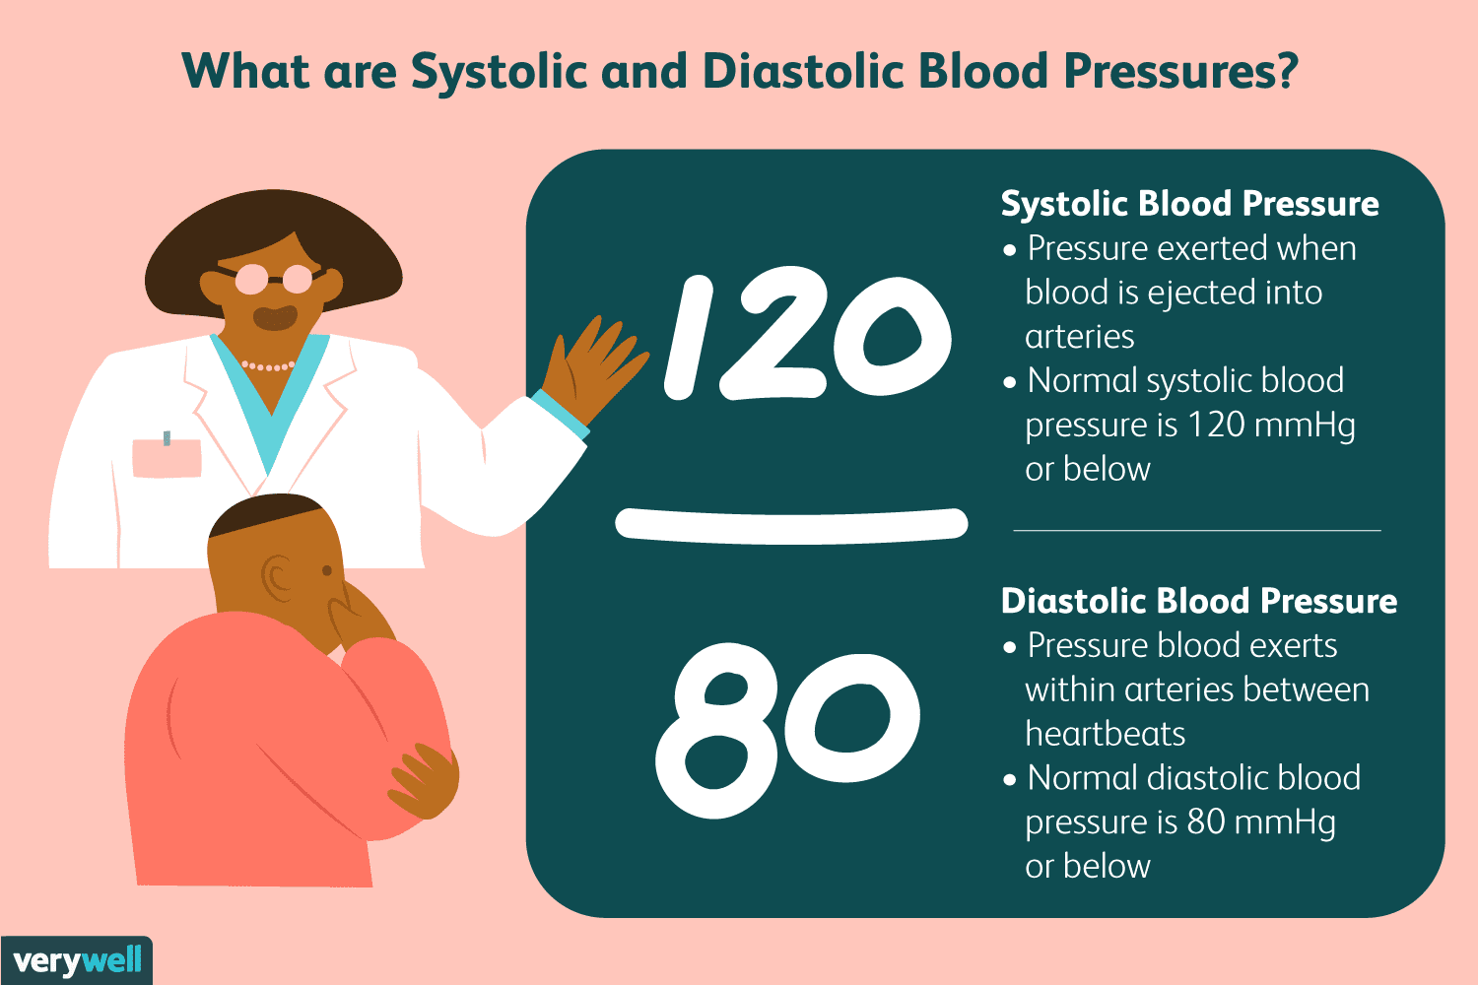
INTRODUCTION
Blood Pressure: The pressure of the blood in the circulatory system,
In 2019, more than half a million deaths in the United States had hypertension as a primary or contributing cause.¹
Treatments for high blood pressure include a change in lifestyle and prescription medications including: Angiotensin-converting enzyme (ACE) inhibitors and angiotensin II receptor blockers (ARBs), Calcium channel blockers, Diuretics, and Beta Blockers.²
Notes:
Facts about hypertension. Centers for Disease Control and Prevention. https://www.cdc.gov/bloodpressure/facts.htm. Published September 27, 2021. Accessed April 26, 2022.
Blood pressure medicines. MedlinePlus. https://medlineplus.gov/bloodpressuremedicines.html. Published November 5, 2021. Accessed April 26, 2022.

Slide 3
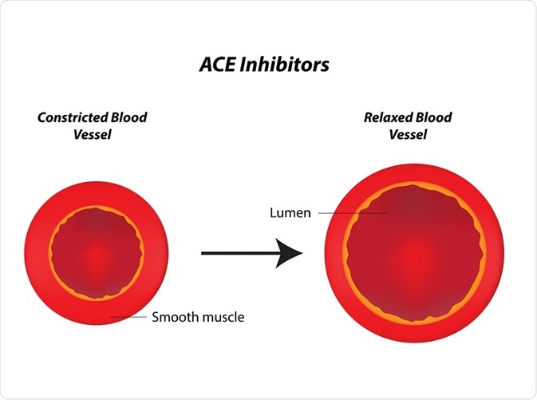
ACE Inhibitors
ACE inhibitors will reduce the left ventricular afterload which is the force used to promote forward blood flow through the heart³
With this, the inhibitors also diminish cardiac mass and wall thickness.⁴
Phosphorus-containing ACE inhibitor. Fosinopril – Hypertension therapy dosing is 10 mg - 80 mg. May split into two equal doses during the day to control blood pressure.
Notes:
Frohlich ED. Angiotensin converting enzyme inhibitors. Present and future. Hypertension. 1989;13(5 Suppl):I125-I130. doi:10.1161/01.hyp.13.5_suppl.i125
Goyal A, Cusick AS, Thielemier B. ACE Inhibitors. [Updated 2021 Jul 8]. In: StatPearls [Internet]. Treasure Island (FL): StatPearls Publishing; 2022 Jan-. Available from: https://www.ncbi.nlm.nih.gov/books/NBK430896/

Slide 4
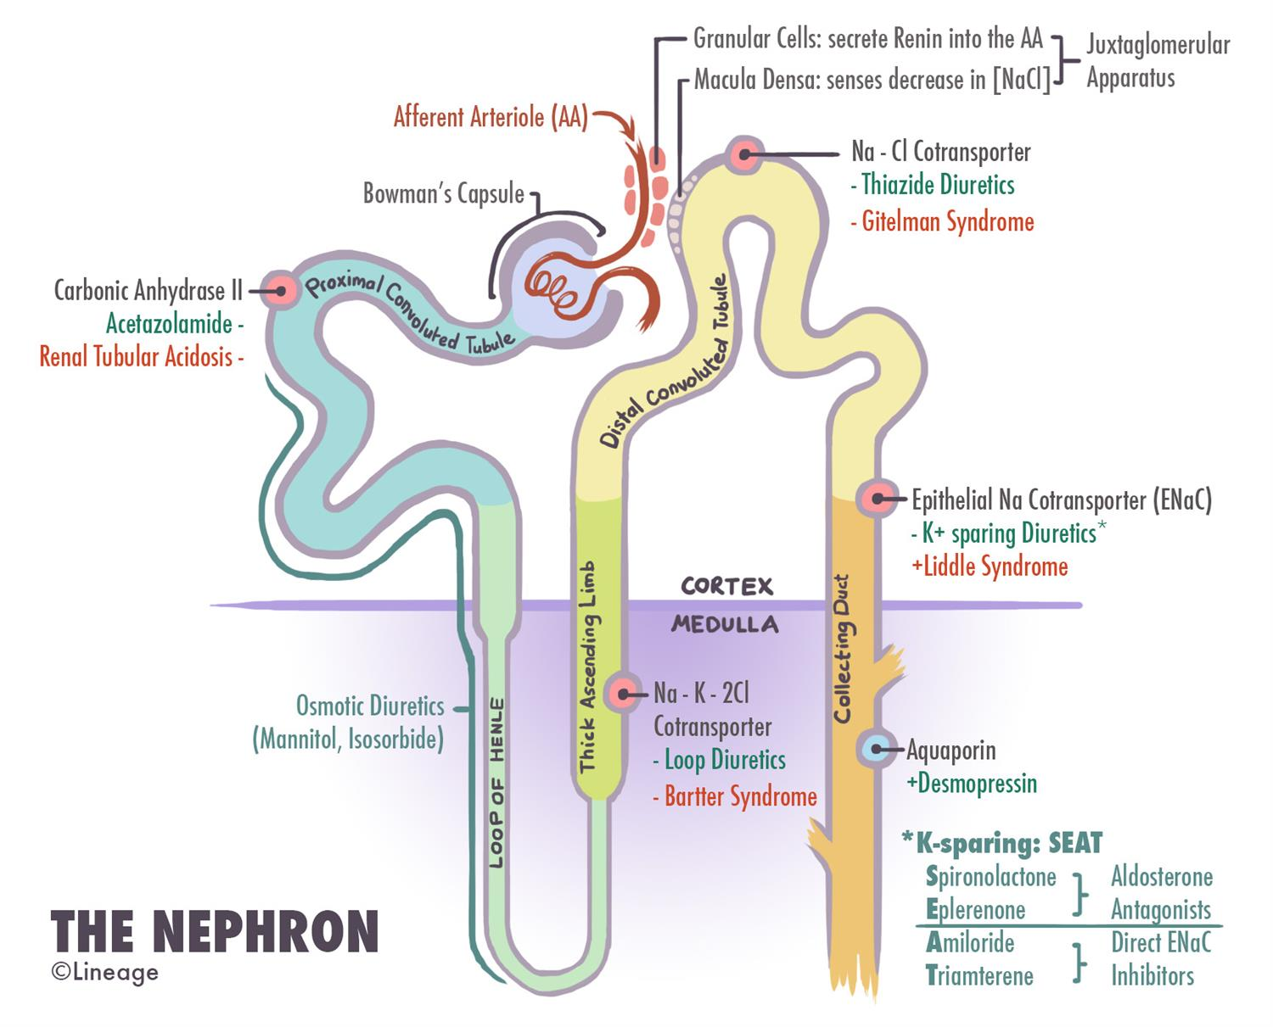
Diuretics
Causes the kidneys to create more urine. Helping the body get rid of extra fluid and salt.
Thiazide diuretics used as the first-line treatment for HTN in all age groups regardless of race unless the patient has evidence of chronic kidney disease.⁵
Chlorthalidone, when compared with lisinopril, was better in preventing cardiovascular disease,
Notes:
Khalil H, Zeltser R. Antihypertensive Medications. [Updated 2022 Jan 19]. In: StatPearls [Internet]. Treasure Island (FL): StatPearls Publishing; 2022 Jan-. Available from: https://www.ncbi.nlm.nih.gov/books/NBK554579/

Slide 5
Hypothesis
Does an ACE inhibitor (Fosinopril) decrease blood pressure in hypertensive patients aged 30-65 at a higher rate than a standalone standard diuretic (Chlorthalidone) during a short term period (1 month)?

Slide 6

Methods: Study Population
Patients were selected from Houston Methodist Hospital in Houston, Texas.
inclusion criteria: Huston resident aged 30-65 diagnosed with hypertension for the first time in their lives.
Exclusion criteria: Patients already on hypertensive medications, pregnant women, visually impaired or person with hearing loss, any bed-ridden patients, participants diagnosed with kidney disease, cancer, heart disease, chronic obstructive pulmonary disease, and mental illness.

Slide 7
Data Collection
Baseline data obtained from primary physicians during initial study period: July 23rd-27th of 2018.
Follow up data recorded Aug 23rd-29th of 2018
The baseline and follow up data included blood pressure, BMI, age, and sex of the patient

Slide 8


(Chlorthalidone)
(Fosinopril)
Double Blind Study
30-day supply of 35mg, which should be taken orally in the morning with food.
30-day supply of 25mg was given for the intervention participants to split orally into two equal doses during the day to control blood pressure.

Slide 9
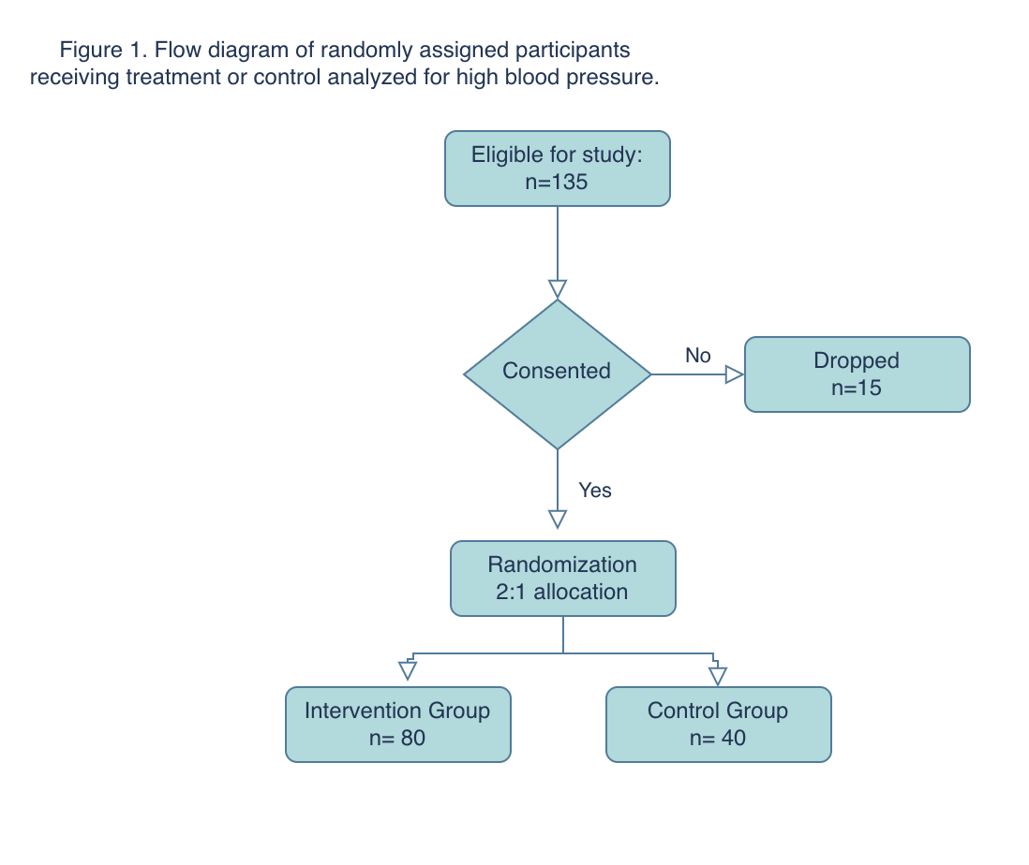

Slide 10
Results

Slide 11
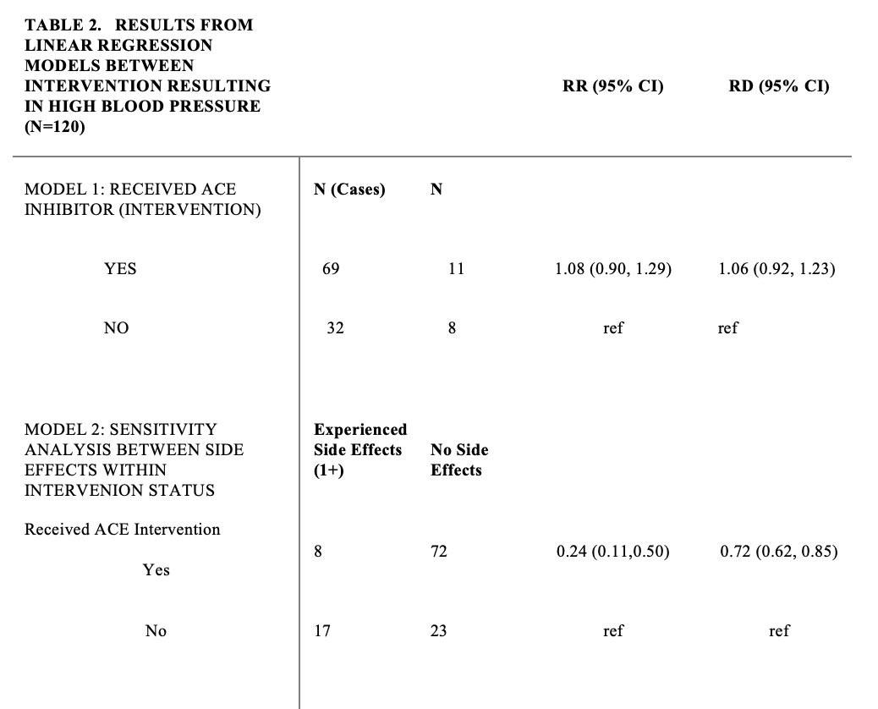
Results: Linear regression
CI: Confidence interval; RR: Risk Ratio; RD: Risk Difference

Slide 12

Discussion:
No difference in effectiveness between the ACE inhibitor and Thiazide Diuretic.
Our secondary analysis regarded the major side effects that participants experienced during this study:
Hyperkalemia: High potassium blood level
Syncope: Temporary loss of consciousness caused by a fall in blood pressure.
Hyperglycemia: High blood sugar:
Hyponatremia: Low sodium levels
.

Slide 13
Discussion
The intervention group who received the ACE inhibitor had .25 the risk of having side effects compared to those taking the Diuretic

Slide 14

Discussion: Limitations
Unknown and Unmeasured confounders
Adherence
Selection Bias
Information Bias

Slide 15
References
Facts about hypertension. Centers for Disease Control and Prevention. https://www.cdc.gov/bloodpressure/facts.htm. Published September 27, 2021. Accessed April 26, 2022.
Blood pressure medicines. MedlinePlus. https://medlineplus.gov/bloodpressuremedicines.html. Published November 5, 2021. Accessed April 26, 2022.
Frohlich ED. Angiotensin converting enzyme inhibitors. Present and future. Hypertension. 1989;13(5 Suppl):I125-I130. doi:10.1161/01.hyp.13.5_suppl.i125
Goyal A, Cusick AS, Thielemier B. ACE Inhibitors. [Updated 2021 Jul 8]. In: StatPearls [Internet]. Treasure Island (FL): : https://www.ncbi.nlm.nih.gov/books/NBK430896/
Khalil H, Zeltser R. Antihypertensive Medications. [Updated 2022 Jan 19]. In: StatPearls [Internet]. Treasure Island (FL): StatPearls Publishing; 2022 Jan-. Available from: https://www.ncbi.nlm.nih.gov/books/NBK554579/

Slide 16
Thank you, Questions?
Lizbeth Vasquez

